Slide 1

Case Study 2
FRITO LAY Attrition Analysis

Slide 2
Overview
Frito-Lay wants to prevent voluntary employee turnover by identifying the factors that leads to Attrition. They’ve provided their current employee data (sans PII) for us to perform our analysis.
In this presentation, I’ll provide the top 3 factors that leads to Attrition; Trends I observed in the data; a Naïve Bayes model to classify Attrition, and a regression model to predict Monthly Income.

Slide 3
METHODOLOGY
Loaded the data set provided (CaseStudy2-data.csv)
Performed Exploratory Data Analysis to identify key factors that leads to Attrition and find explanatory variables for the Linear Regression Model.
Used the Naive Bayes to achieve Classification
Used Linear Regression to predict the Monthly Income.

Slide 4
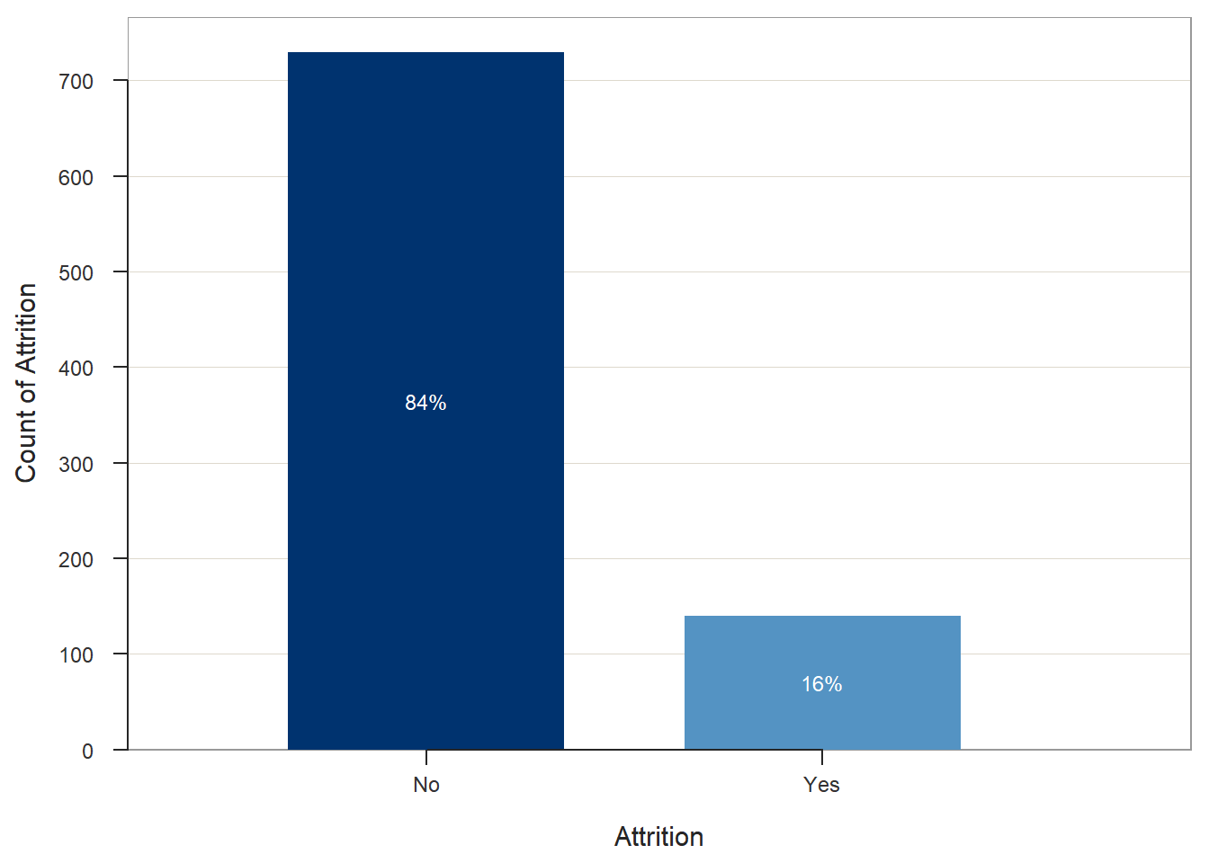
Attrition Facts
Attrition | Count | Percent
No | 730 | 84%
Yes | 140 | 16%
Notes:
Attrition accounted for 16% of the observations within the dataset.

Slide 5
TOP 3 FACTORS LEADING TO ATTRITION
Overtime
Job Level
Monthly Income

Slide 6
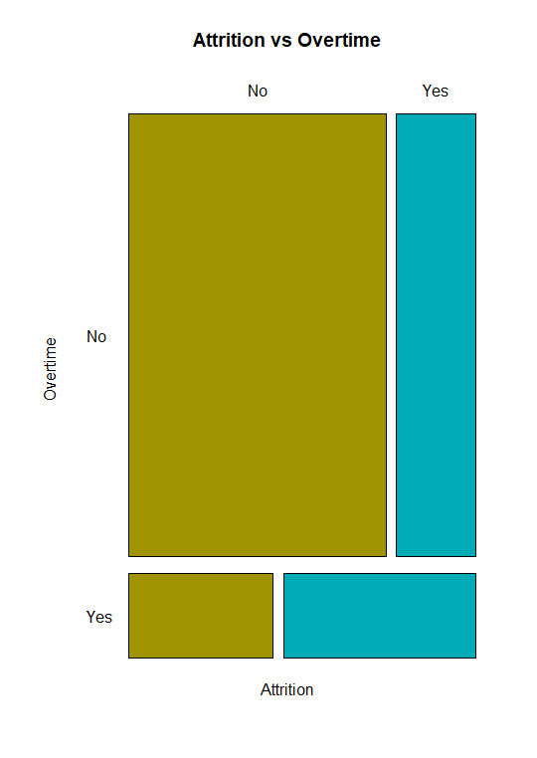
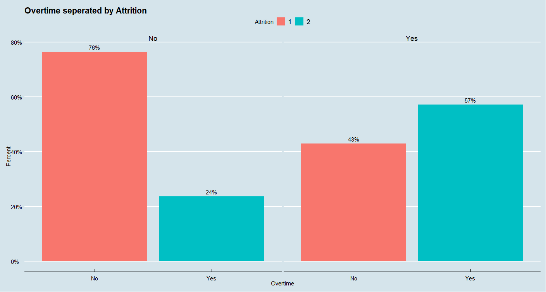
Attrition Factor - Overtime
Notes:
# 29% of all employees work Overtime
# 71% of all employees do not work Overtime
# 57% of persons who left the company were working overtime! This will be one of the factors that leads to Attrition
# Attrition was highest in the group of employees that worked overtime

Slide 7
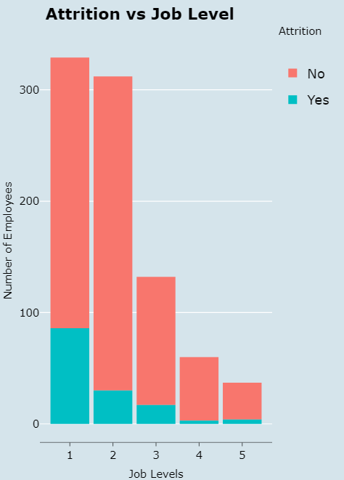
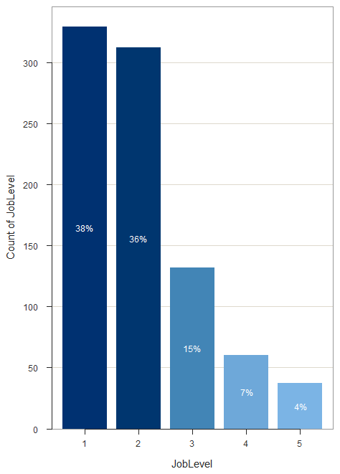
ATTRITION FACTOR - job Level
As Job level increases, Attrition decreases
Attrition occurred at the lowest job level
Notes:
# JobLevel is a factor for Attrition. As Job level increases, Attrition decreases. More Attrition occurred with folks at the lowest job level.
# 38% of the workforce is a Job Level 1. The Recommendation would be to assess your strong employees and Promote them as quickly as possible.

Slide 8
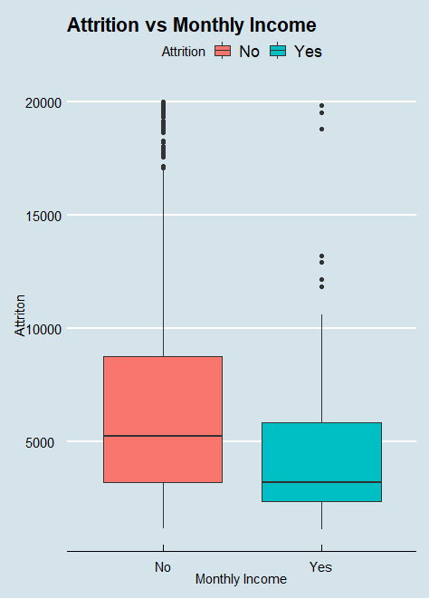
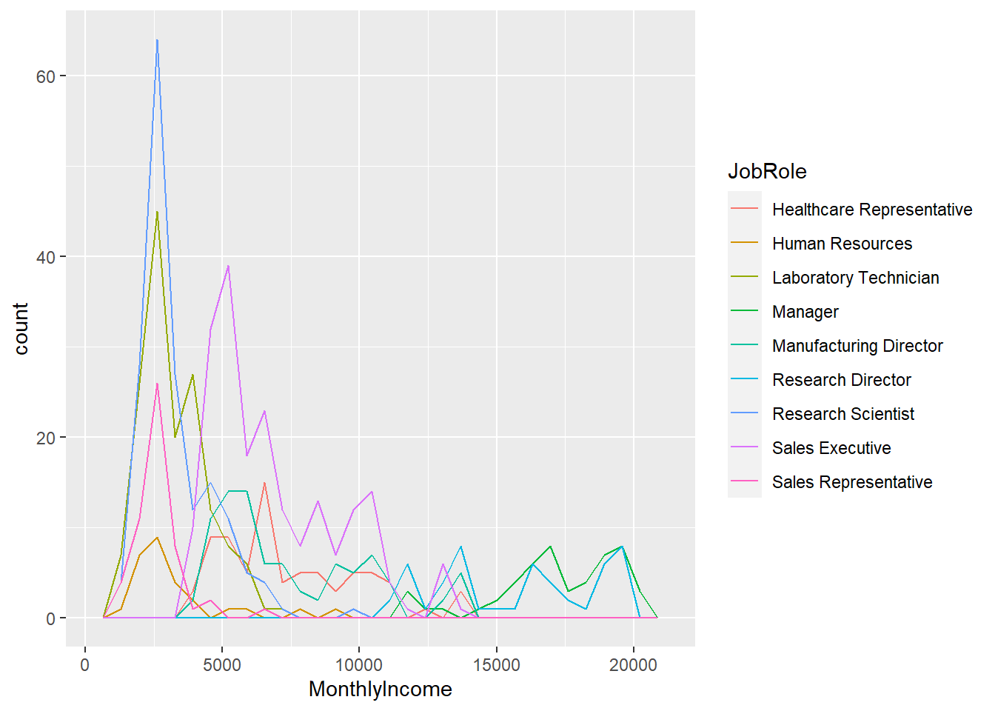
ATTRITION FACTOR - Monthly Income
Notes:
# Employees with lower monthly incomes are more like to leave to the company. The average MonthlyIncome was way lower than those who stayed with the company. Monthly Income is a factor for Attrition
the people with salary less than $5,000 is greatest among the Research and Development Department

Slide 9
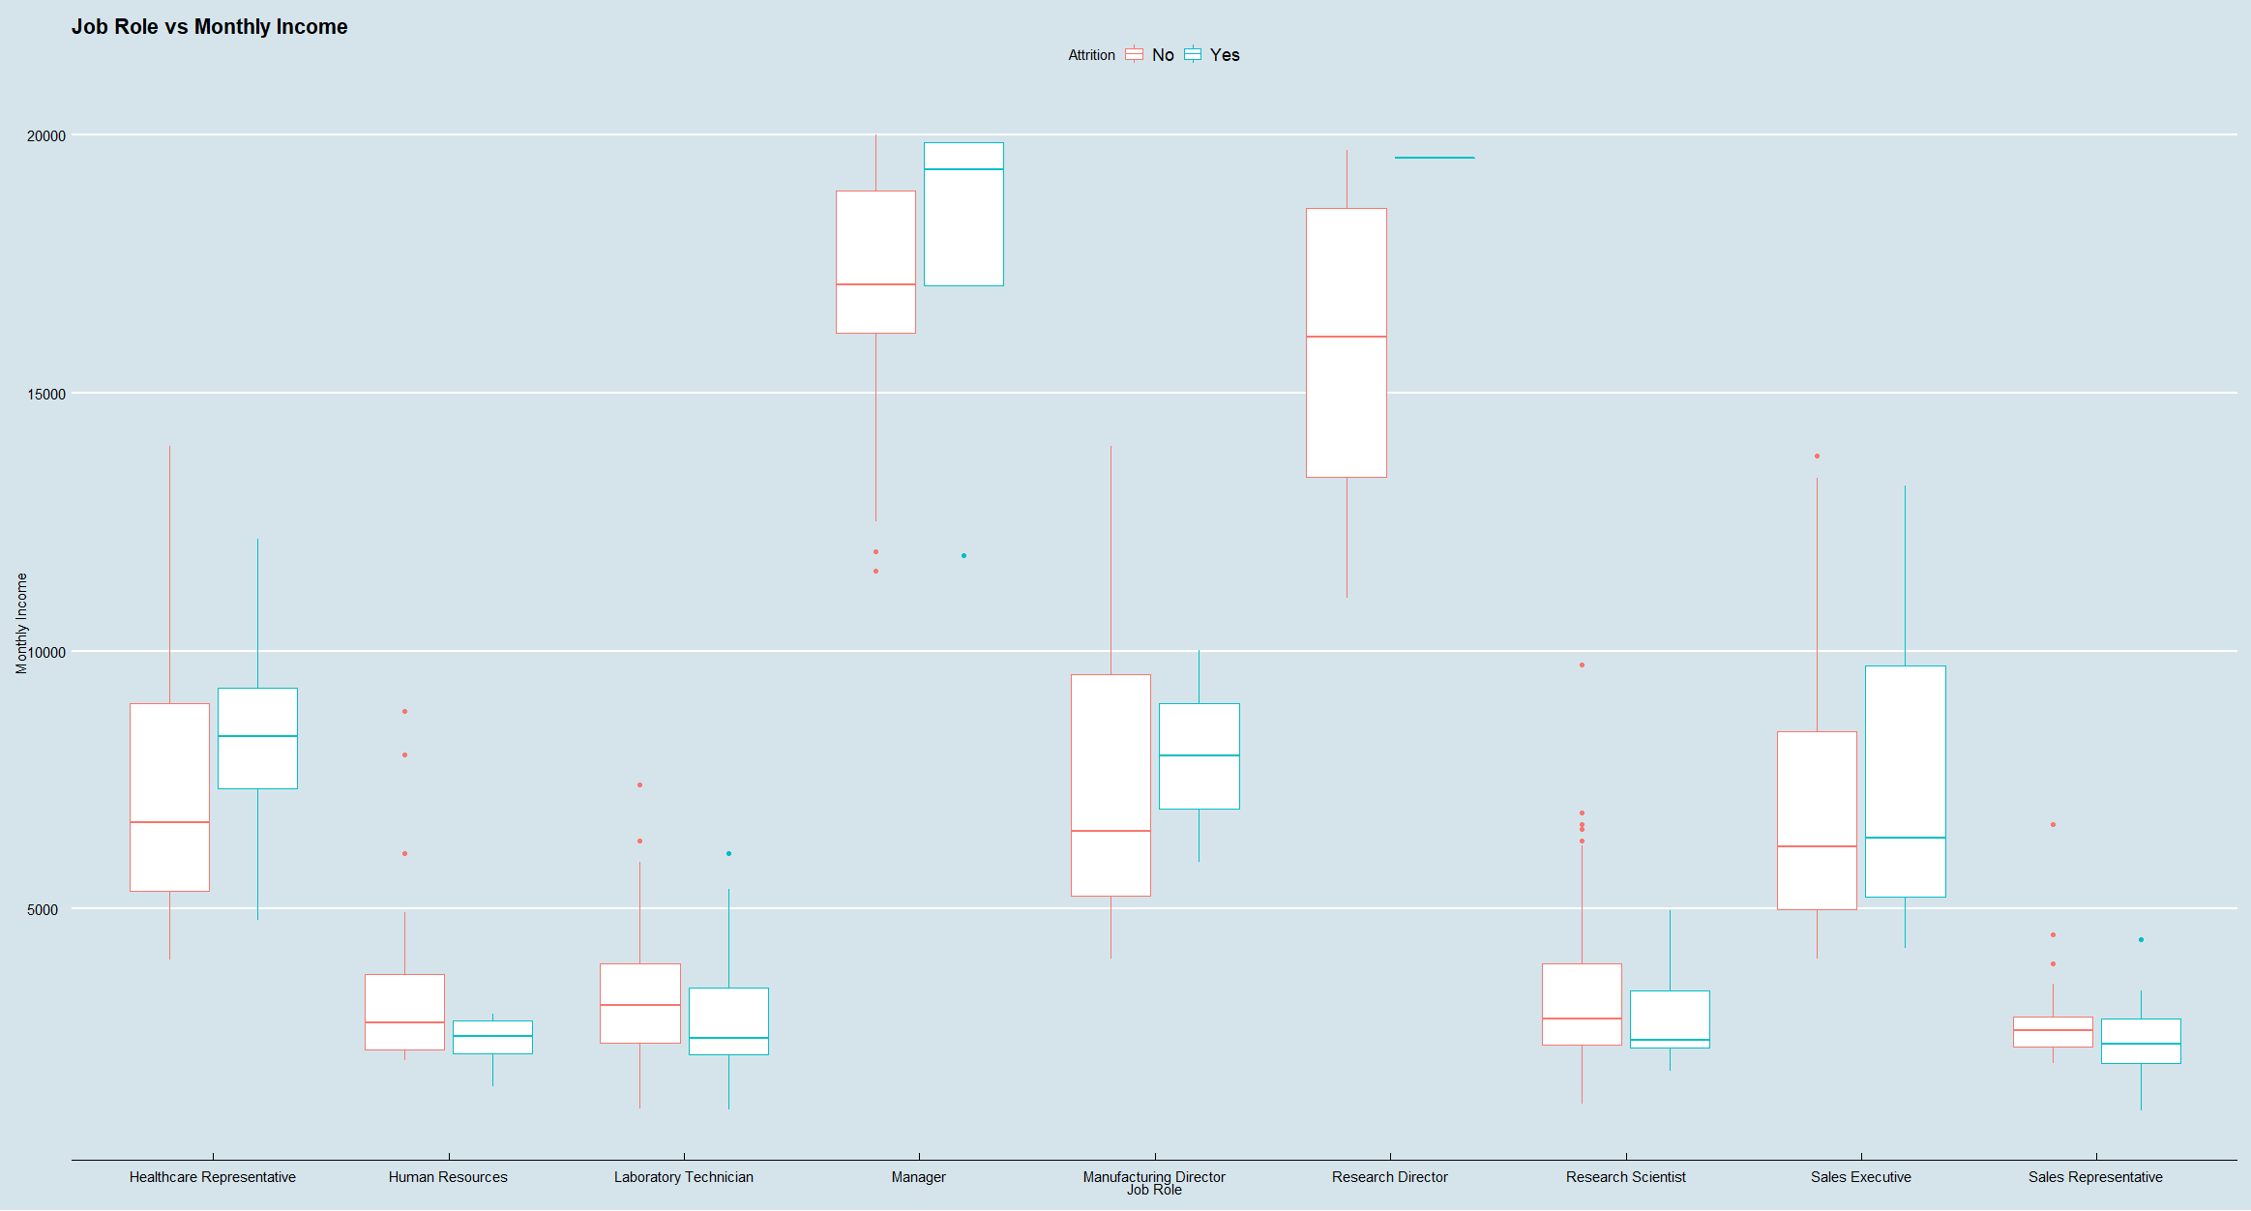
ATTRITION FACTOR - Monthly Income

Slide 10
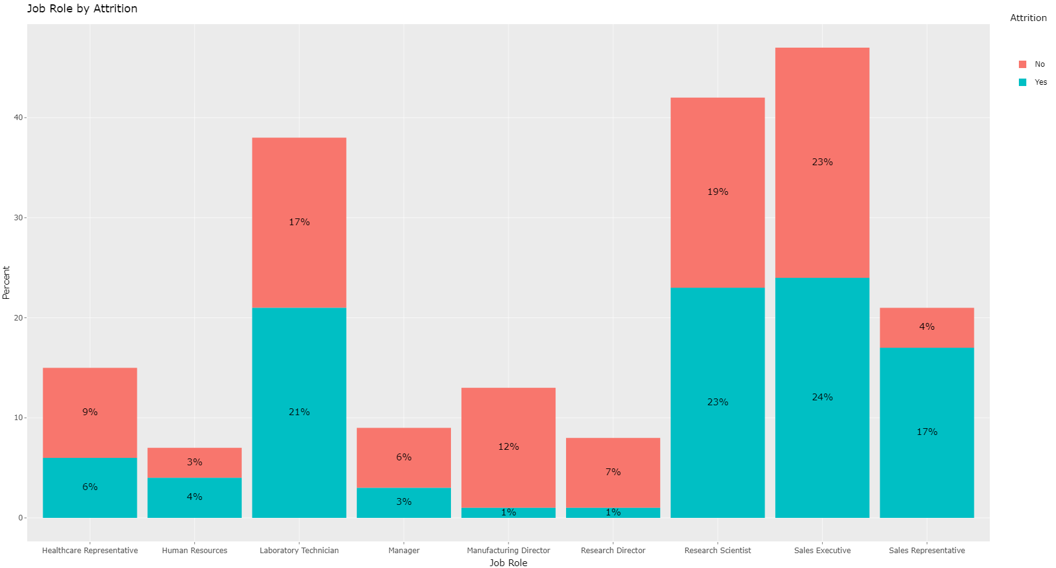
JOB ROLE
Notes:
# Research Scientist Job Role had the most Overtime at 26%
# Research Scientist are the highest among those making less than $5,000. They start out a little higher than other roles. but only less than 5 are making over $10,000

Slide 11
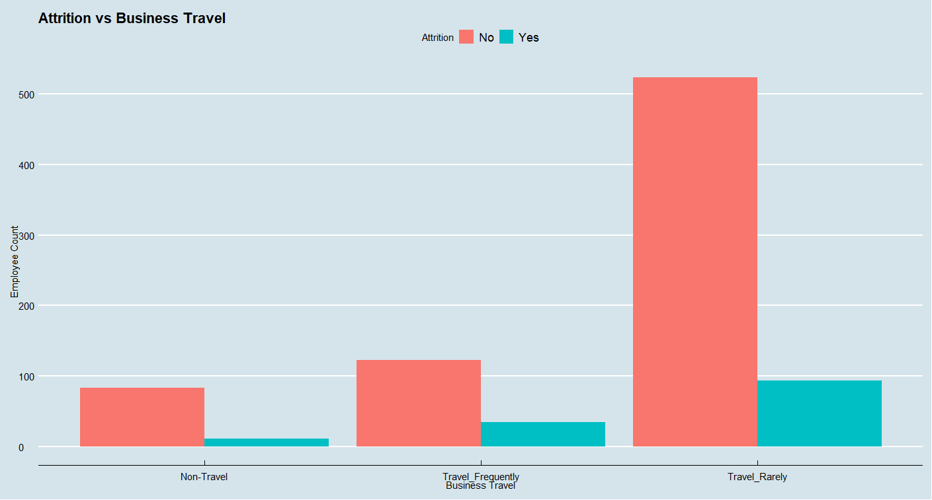
TRAVEL RARELY

Slide 12
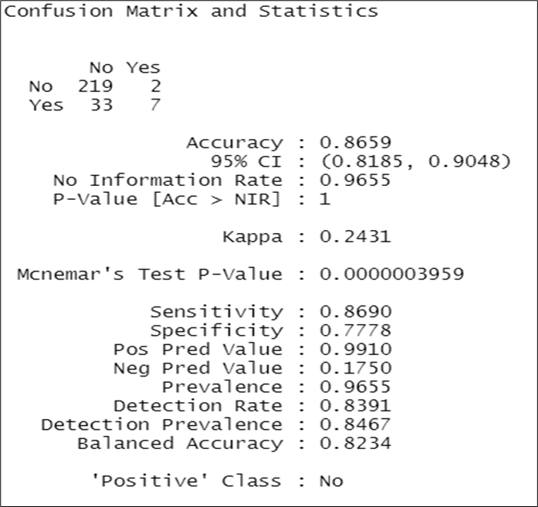
NAÏVE BAYES Classification
Response Variable
Attrition
Explanatory Variables:
Overtime
Monthly Income
Job Level

Slide 13
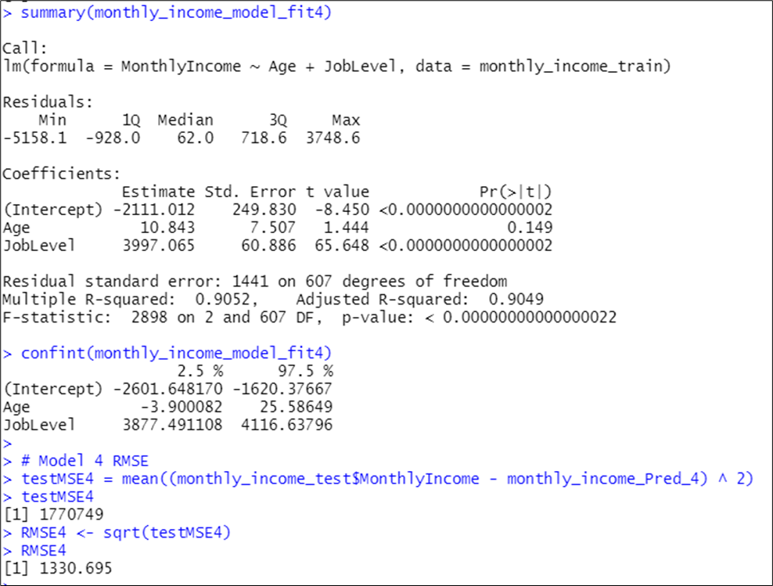
Linear Regression Model
Response Variable
Monthly Income
Explanatory Variables:
Age
Job Level
RMSE
$1330.695

Slide 14
Links
GitHub Repository: https://github.com/RayonM/CaseStudy2DDS
GitHub Website: https://rayonm.github.io/index.html

